Slide 1

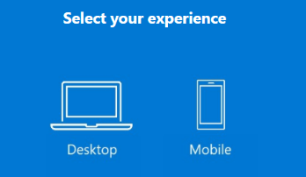
Exercise 00 Microsoft Teams Intro
Quick Intro to Microsoft Teams
We’ll be using Microsoft Teams to produce our virtual event. You’ll need a basic familiarity with the Microsoft Teams user interface.
Go to http://teamsdemo.office.com
Follow the prompts!
TIP: This is a great getting started resource if you do an internal training session or lunch & learn
Notes:
FACILLITATOR NOTES
Participants may be Teams users already – sue your judgement if you want them to complete this
You can give a guided overview by following along at https://teamsdemo.office.com

Slide 2
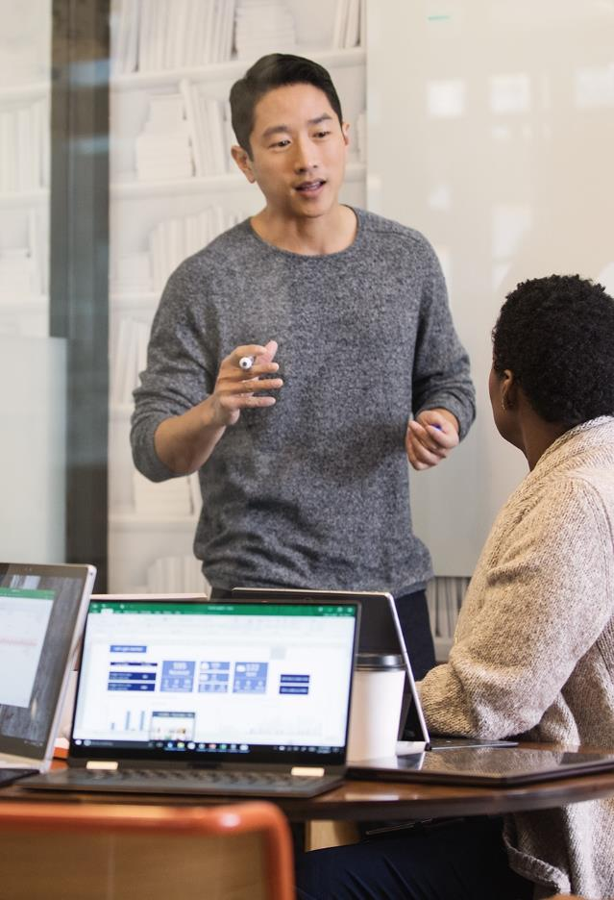
Workshop Lab Environment
Tenant
M365x315745.onmicrosoft.com
Your ‘Persona’ Today
FirstL@M365x315745.onmicrosoft.com
password.1
Notes:
FACILLITATOR NOTES
Make sure everyone figured out which persona they have before continuing
Poll the room for any other technical issues before continuing (can they log in to the workstation, etc.)

Slide 3
Participant | Company | Lab Persona | Persona Email
Angie Wyatt | AES Corporation | Debra Berger*** | DebraB@M365x315745.OnMicrosoft.com
Lauren Hutto | AES Corporation | Debra Berger*** | DebraB@M365x315745.OnMicrosoft.com
Mary Head | CLA | Nestor Wilke | NestorW@M365x315745.OnMicrosoft.com
Silvia Alonso-Falip | Coyote Logistics, LLC. | Miriam Graham**** | MiriamG@M365x315745.OnMicrosoft.com
Robert Thornburg | Coyote Logistics, LLC. | Miriam Graham**** | MiriamG@M365x315745.OnMicrosoft.com
Jeremy Haug | Cummins Inc. | Alex Wilber | AlexW@M365x315745.OnMicrosoft.com
Nishant Jain | Cummins Inc. | Allan Deyoung | AllanD@M365x315745.OnMicrosoft.com
Vidya Sangolli | Cummins Inc. | Allan Deyoung | AllanD@M365x315745.OnMicrosoft.com
Michael Shepherd | Cummins Inc. | Adele Vance | AdeleV@M365x315745.OnMicrosoft.com
Anthony Williams | Cummins Inc. | Allan Deyoung* | AllanD@M365x315745.OnMicrosoft.com
Nicola Licata | Dana Incorporated | Patti Fernandez** | PattiF@M365x315745.OnMicrosoft.com
Matt Singh | Dana Incorporated | Patti Fernandez** | PattiF@M365x315745.OnMicrosoft.com
Jack Mankin | Mclane Company | Pradeep Gupta | PradeepG@M365x315745.OnMicrosoft.com
Julie Heironimus | Nebraska Furniture Mart | Irvin Sayers | IrvinS@M365x315745.OnMicrosoft.com
April Jackson | Nebraska Furniture Mart | Diego Siciliani | DiegoS@M365x315745.OnMicrosoft.com
Tiffaney Kuper | Nebraska Furniture Mart | Grady Archie | GradyA@M365x315745.OnMicrosoft.com
Bryan Kelly | Patterson Companies | Lee Gu | LeeG@M365x315745.OnMicrosoft.com
Samuel Mueller | Patterson Companies | Joni Sherman | JoniS@M365x315745.OnMicrosoft.com
Matthew Page | Patterson Companies | Johanna Lorenz | JohannaL@M365x315745.OnMicrosoft.com
Sheila Miller | Polaris | Isaiah Langer | IsaiahL@M365x315745.OnMicrosoft.com
Tammy Jelinek | Wipfli LLP | Megan Bowen | MeganB@M365x315745.OnMicrosoft.com
Michael Pynch | Wipfli LLP | Lidia Holloway | LidiaH@M365x315745.OnMicrosoft.com
Nick Schweitzer | Wipfli LLP | Lynne Robbins | LynneR@M365x315745.OnMicrosoft.com
Sign into the Workshop Lab Environment
Open a Private Browsing or InPrivate Window
In the browser go to teams.microsoft.com
Log in as your Persona
Use the email at left
Password is “password.1”
3. Click No when asked Stay Signed In.
4. Click Use the web app if prompted

Slide 4
Exercise 01 Sign into the Workshop Lab Environment
Open an InPrivate Browser Window
Google Chrome - Click on the Chrome menu and select > New incognito window
Microsoft Edge - Click the 3-dotted More link and select New InPrivate window
Apple Safari (Mac) - Go to File > New Private Window from the menu bar.
Log into Teams
In the browser go to http://teams.microsoft.com
Log in as your Workshop Persona:
FirstL@M365x315745.onmicrosoft.com
password.1
Click No when asked Stay Signed In.
click Use the web app instead if prompted
Notes:
FACILLITATOR NOTES
We want everyone signed in to teams.microsoft.com and signed into the desktop Teams client
WORKSHOP PRE-FLIGHT FOR THIS SECTION
Provision a Transform tenant
Secure/Print Persona Tent Cards, set out by A/B/C groupings (in Person)
Secure/Print Persona Worksheet (in Word) (in Person)

Slide 5
Exercise 02 OneNote Lab Notebook and Workshop Personas
Setup Lab Notebook
Open a new tab in your Private Browser window
Go to https://aka.ms/contosolab/notebook
Microsoft OneNote Online will open in your browser
In OneNote online, open the section Lab Exercises
Note the upcoming Exercises on individual pages
Find Other Participants
In OneNote online, open the section Participants
Note who logged in as the various personas
Notes:
FACILLITATOR NOTES
May need to walk thru how to find the BTA Workshop team in Teams
Open BTA Workshop > Participants in the browser so we can see personas populate in real time
WORKSHOP PRE-FLIGHT FOR THIS SECTION
Create the team “BTA Workshop” in Microsoft Teams in the demo tenant as a public team
Open the OneNote notebook associated with the BTA Workshop group
Copy the staged workshop notebook sections into the shared Notebook
Create an AKA link to make accessing easy

Slide 6
Create a New list
Go to www.office.com
In the App Launcher (upper left icon) select All Apps > Microsoft Lists
Click New List
Work with an Existing List
Go to https://aka.ms/contosolab/wellnesslist
Click the Filter, Sort, and View buttons to change the view and layout of the list
Discussion
Managing information in Microsoft Lists
Exercise 03 Create a Microsoft list

Slide 7
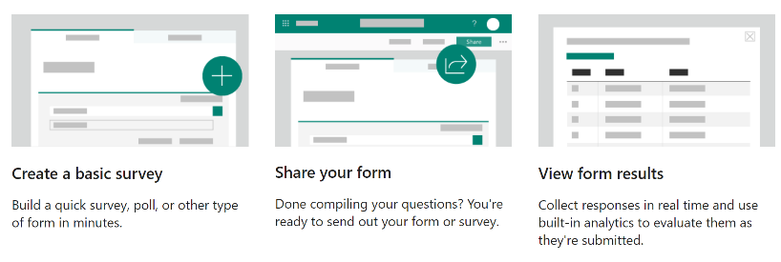
Microsoft Forms
For Virtual Events
Registration forms for Attendees, Speakers
Feedback forms for sessions and evaluations
Quizzes, Engagement, and Knowledge Check
For registration for Meetings and Webinars

Slide 8
Complete a Form
Go to https://aka.ms/contosolab/conferenceregistration
Complete the form and click Submit
Create a Form
Go to https://forms.office.com
Follow instructions the lab notebook
Demo
Form Results
Leverage Form Results with PowerShell
Exercise 04 Working with Microsoft Forms

Slide 9
Exercise 05 National Sales Conference
Team
SharePoint Site
Notes:
FACILLITATOR NOTES
Make participants aware of the playbook, and share follow-up link
WORKSHOP PRE-FLIGHT FOR THIS SECTION
Update Persona Worksheets.docx with correct CIE Tennant
Create Teams Live Event in tenant, adding personas as Producer/Presenter/Attendee
CIE Administrator - Producer
A, B – Attendee
C - Presenter

Slide 10
Submit an Idea
Go to https://aka.ms/contosolab/topicidea
Complete the form and click Submit
Discuss Topic Proposals
In Teams go to National Sales Conference team > Conference Planning channel > Proposed Topics
Follow Exercise 6 instructions the lab notebook
Demo
Automating Topic Management in Lists
Export Session List to Excel
Exercise 06 Conference Topics

Slide 11
Work with Planner Tasks
Go to https://tasks.office.com
Add a task in the Event Planning bucket
Explore Boards, Charts, Schedules in Planner
Demo
Automating Task Creation
Work with Planner in Teams
Exercise 07 Managing Event Prep Work in Planner

Slide 12
Conference Sessions List
Find the session assigned to your Persona
Schedule a Channel Meeting
Update the Session List
Discussion
Implications of Channels, Guest Users
Demo
Automating Breakout Session Creation
Exercise 08 Schedule a Channel Meeting, Update Session List

Slide 13
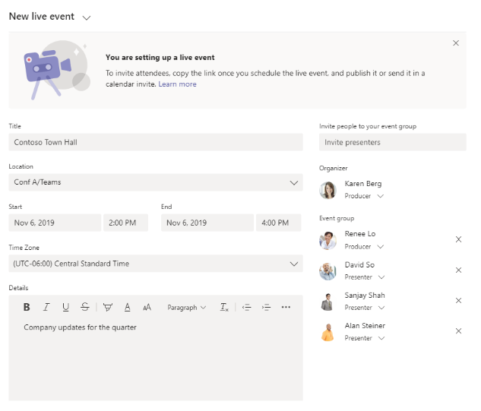
Exercise 09 Schedule a Teams Live Event
Notes:
FACILLITATOR NOTES
Participants should schedule a live event with their cohort.
One person should be Organizer, another Producer, another Presenter

Slide 14
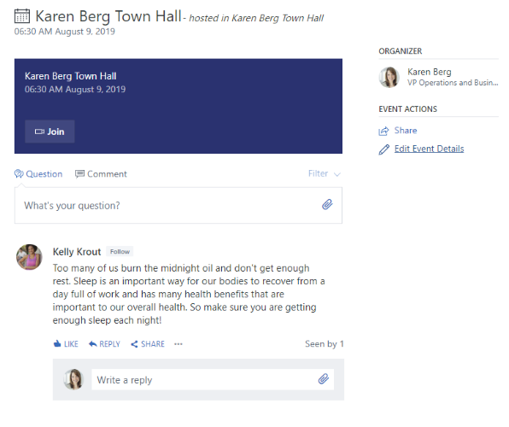
Exercise 10 Schedule a Live Event in Yammer
Notes:
FACILLITATOR NOTES

Slide 15
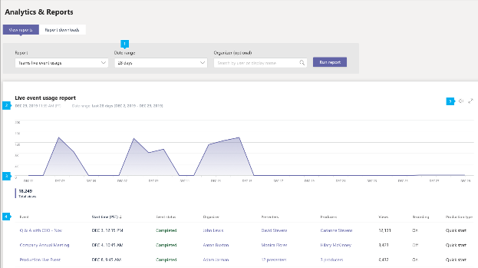
Exercise 11 Teams Live Event Reporting
Notes:
FACILLITATOR NOTES

Slide 16
Exercise 12 Working with Content
Managing Content and Speakers
Working from a Single Source of Truth for Slide Decks
Presentation Coach
Accessibility and Deisgn
Notes:
FACILLITATOR NOTES

